Slide 1
Review for Quiz 4
CSCE 215

Slide 2
Selected Topics - Weeks 7 - 9
vi/vim
File permissions
Sed
Tr
Diff

Slide 3
Vi/Vim
https://vim.rtorr.com/
Important:
i - enter insert mode
Esc :w - write out changes
Esc :wq - write out and quit
Esc : q - just quit
Esc : q! - quit and do not save changes.
:120 - go to line 120
/cat - search for word cat.

Slide 4
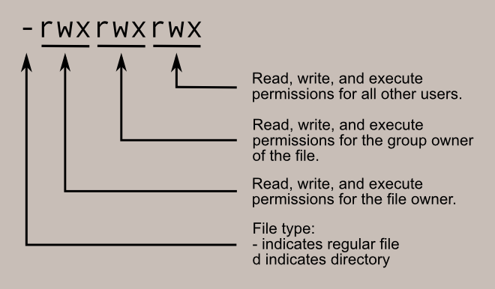
File Permissions
chmod
chmod +x file.sh -> adds execution rights for that file

Slide 5

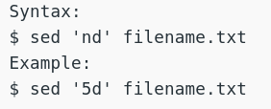
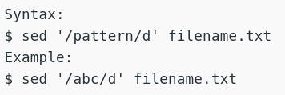
sed command
Replacing text
Replacing text globally
Deleting text
Deleting text based on pattern

Slide 6



tr command
Stands for translate
Basic Syntax
Some examples:

Slide 7
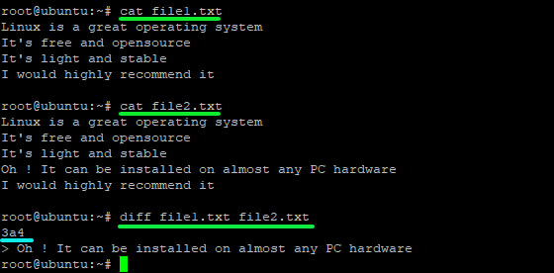

diff command
Finds differences between two files

Slide 8
Questions?

